Slide 1
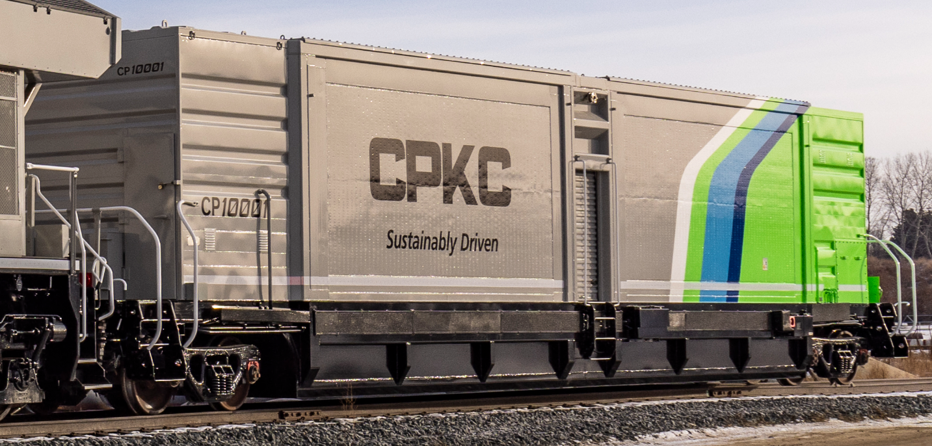
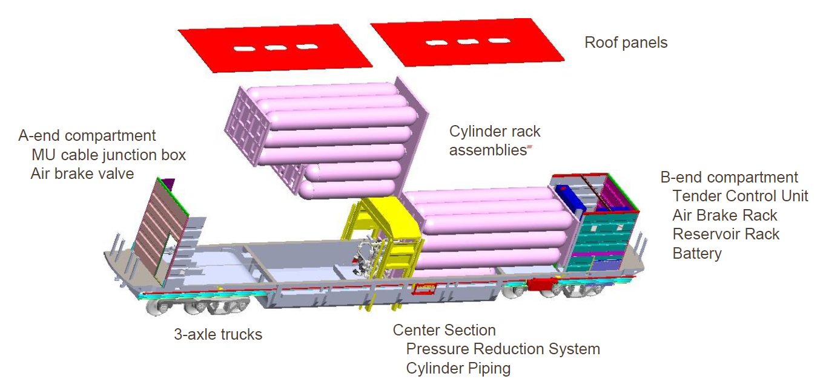
HGmotive Hydrogen Tender Solutions
Compressed Hydrogen
1,900 Kg+ (70+MWh)
Compressed Hydrogen
3,200+ Kg & 4,500+ Kg (120+ & 180+ MWh)
100% emission free
4 axle tender, 284,000 Lbs.
350 Bars Hydrogen pressure
[OEM] technology in operational service
100% emission free
6 axle tender, 420,000 lbs.
700 Bars Hydrogen pressure ( 3,200+ Kg)
700 Bars Cryo-compressed Hydrogen (4.500+ Kg )
4/24/2024

