Slide 1

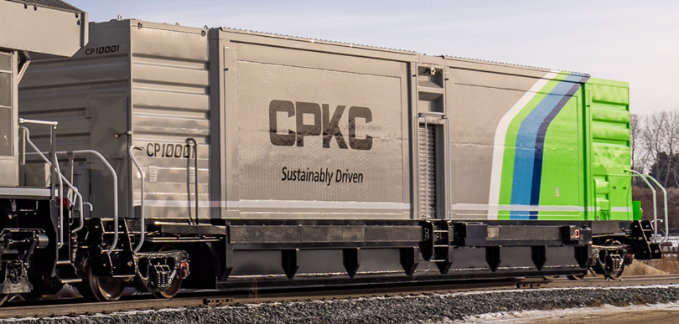
TM
Hydrogen tender in combination with fuel cells or hydrogen internal combustion engines is the only zero emission solution
for long haul rail freight
TM
21016 80thAve. Suite 10, Frankfort, IL,60423 www.hgmotive.com

Slide 2
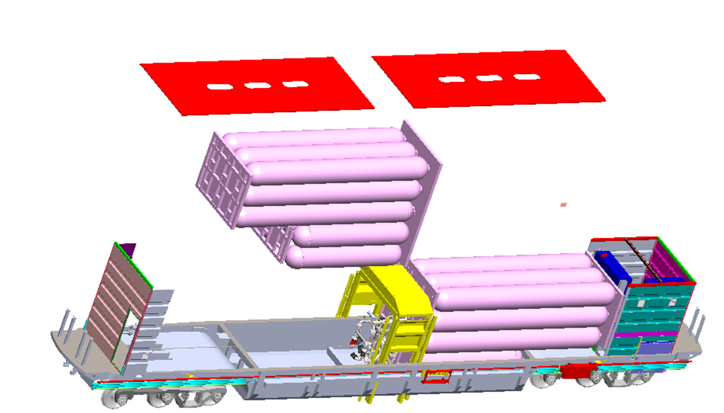
HGmotiveTM Background
HGmotiveTM Tenders
Focused on enabling the use of hydrogen to reduce rail industry emissions.
HGmotiveTM has designed and built
M-1004 compliant tenders to deliver Compressed Hydrogen Gas
  Zero emissions in combination with hydrogen fuel cell locomotives
  Hydrogen-compatible HCNG tenders using blend of hydrogen and CNG
HGmotiveTM has multiple patents that enable a safe high-capacity compressed gas tender to be filled in less than an hour
3200 HYDROGEN TENDER
85 feet long, 390,000 lbs.
Roof panels
A-end compartment
MU cable junction box
Air brake valve
Cylinder rack
assemblies
B-end compartment
Tender Control Unit
Air Brake Rack
Reservoir Rack
Battery
3-axle trucks
Center Section
Pressure Reduction System
Cylinder Piping
HGmotive's Hydrogen Tender is constructed with safety and compliance in mind. It adheres to AAR Standard
M-1004 specifications and includes crashworthiness features that safeguard the hydrogen stored within the tender. Leak detection mechanisms and emergency shutdown functions are incorporated to ensure safe operation.
When coupled with a hydrogen-powered locomotive, the Hydrogen Fuel Tender interacts through a communication cable, controlling the flow of hydrogen. The Tender Control Unit and auxiliary relay panel work in tandem to manage hydrogen flow, regulating valves as needed. The Pressure Reduction System reduces the pressure of hydrogen moving from storage to locomotive-maintaining necessary operating pressure.
TM
21016 80thAve. Suite 10, Frankfort, IL,60423 www.hgmotive.com

Slide 3
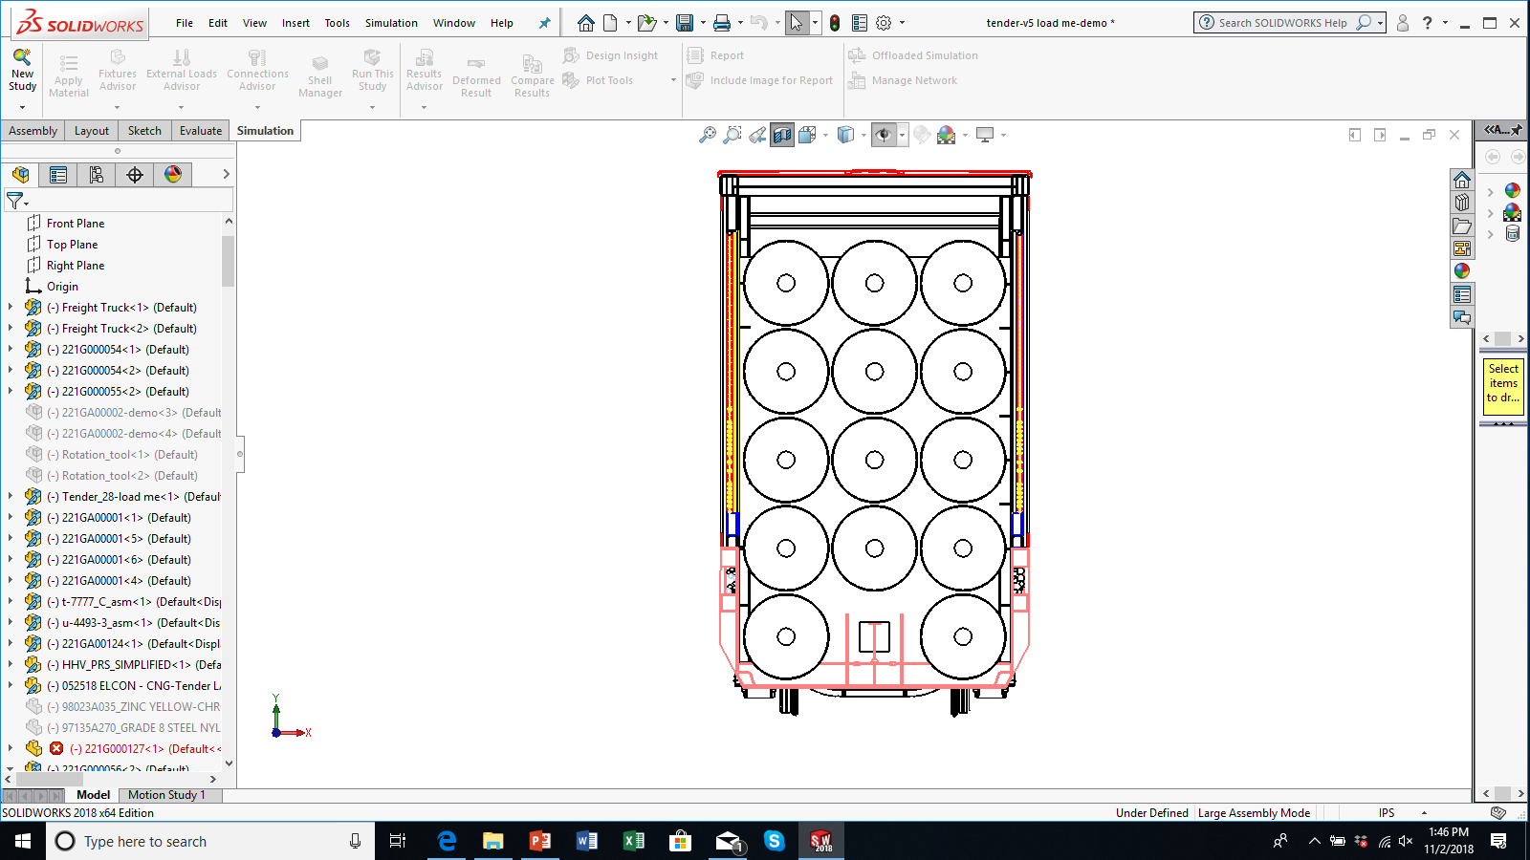
HGmotiveTM AAR M-1004 crashworthy anti- penetration armor (no leak) safety system, tested and compliant with the penetration impact requirements
HGmotiveTM
has engineered and
patented the system
that absorbs >120%
of the energy
HGmotiveTM Tenders Offer
Proven hydrogen tender capacities of up to 4,500kg with zero venting.
HG Motive 6,000 kg H2 capacity tender has effective capacity greater than liquid hydrogen
100% carbon free emissions free for long distance freight rail at distances greater than diesel
Extension of filling intervals for yard and local operations
Fuel cell powertrain development is in the process at OEMs.
Hgmotive’s tenders powering road locomotives currently in mainline freight service
Easy to use and maintain, H2 Compressed gas tenders are enabling rapid and safe implementation of carbon-free energy future for railroading
In Summary HGmotiveTM Tenders:
Only hydrogen tender in the market which complies with M-1004
Safety detection and reaction systems that exceed regulatory requirements
Capacities of hydrogen of 1900Kg, 3200Kg,
4,500 Kg and Cryo-hydrogen up to 6,000 Kg net,
at densities higher than liquid hydrogen
No hydrogen boil off
Easy to fill, no rocket science required to manage fuel conditions or handling
Low cost, efficient compressed Hydrogen, can be made in yard
TM
21016 80thAve. Suite 10, Frankfort, IL,60423 www.hgmotive.com

